Slide 1
West Area Planning Committee Presentation
Application reference number
16/02689/CND11
Application site address
Former Cooper Callas, Unither House,
15 Paradise Street

Slide 2
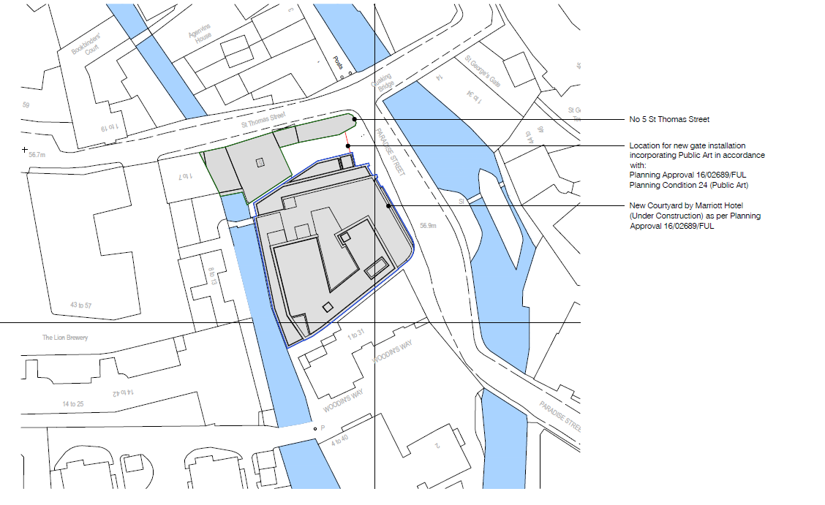

Slide 3
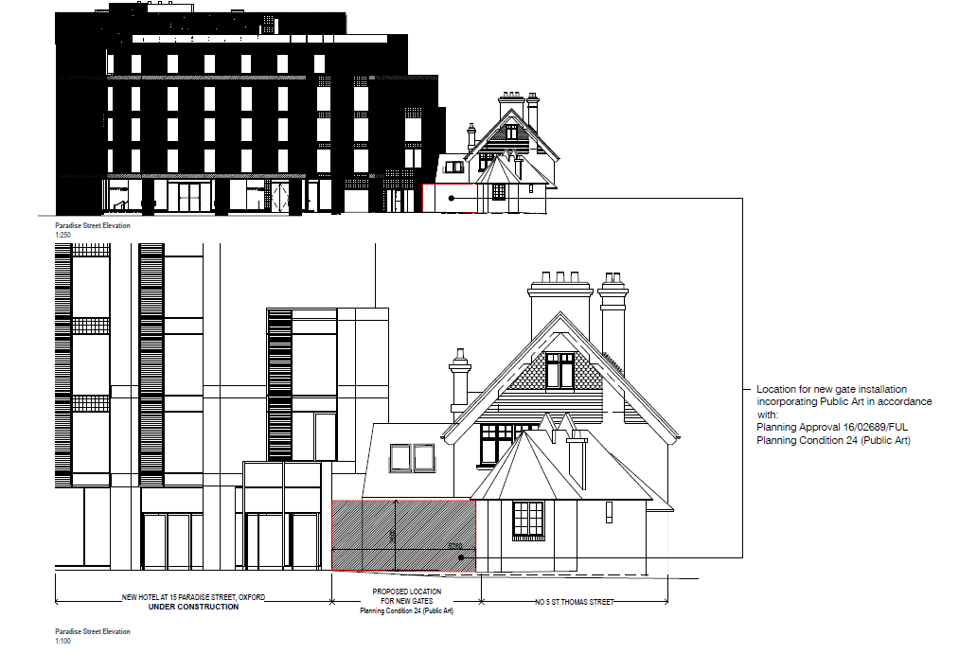

Slide 5
